Slide 1
Python : Dictionaries and Sets

Slide 2
Content
Create Dictionary
Dictionary Operations
Dictionary methods keys and values
Create Set
Working with Set

Slide 3
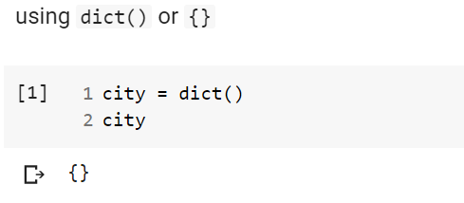
Create dictionary

Slide 4
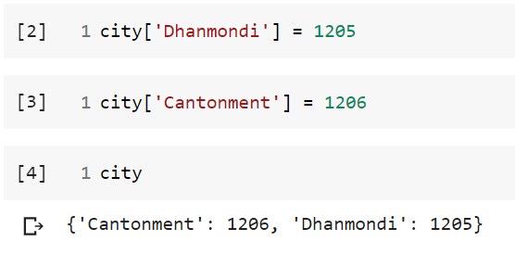
Add value into dictionary

Slide 5
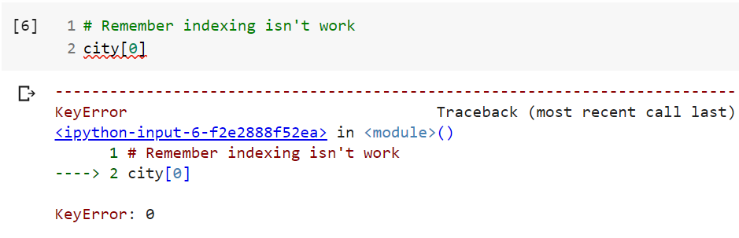
Iterate a dictionary

Slide 6
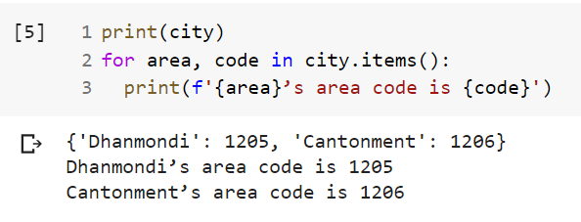
Iterate a dictionary

Slide 7
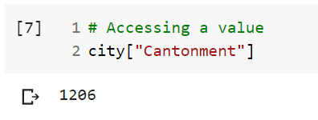
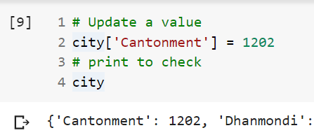
Dictionary operations

Slide 8
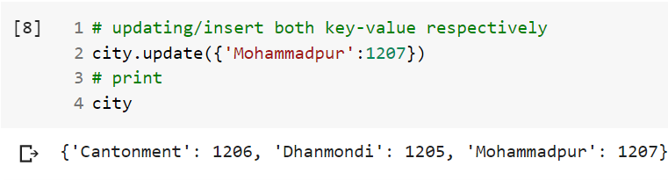
Dictionary operations

Slide 9
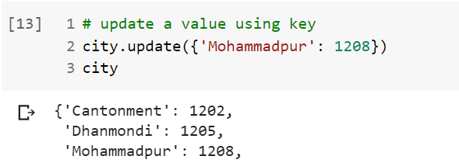
Dictionary operations

Slide 10
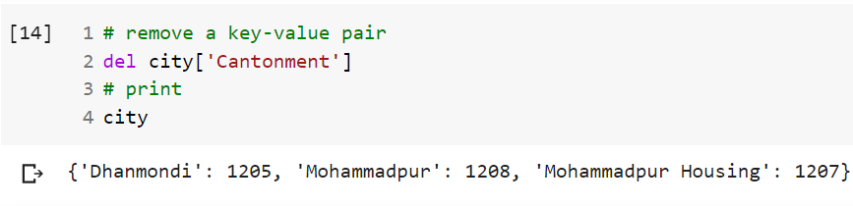
Dictionary operations

Slide 11
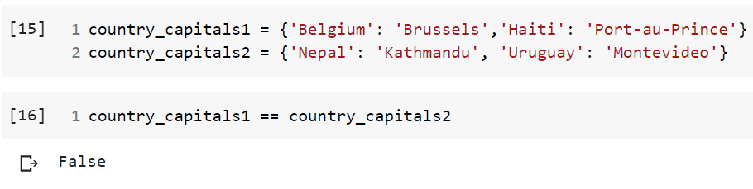
Compare two Dictionaries

Slide 12
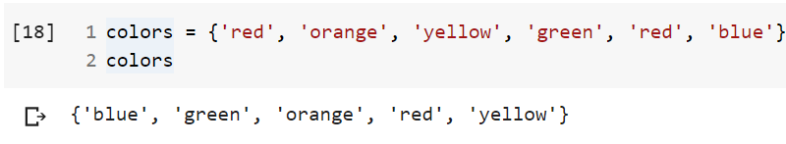
Create set

Slide 13
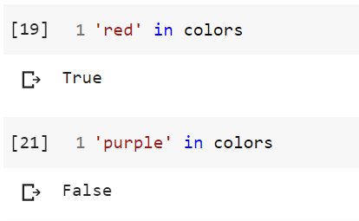
Checking element into Set or not

Slide 14
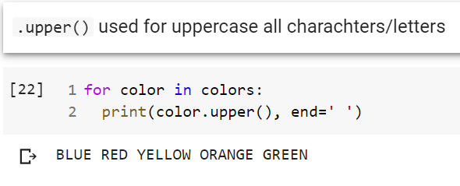
Set operation

Slide 15
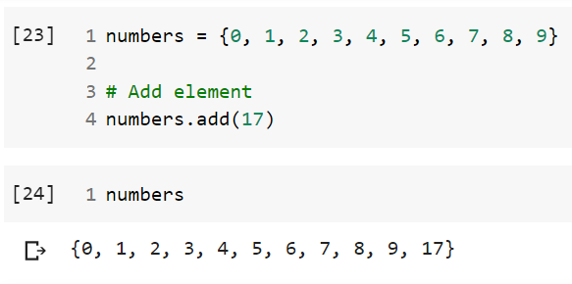
Set methods

Slide 16
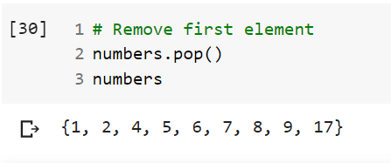
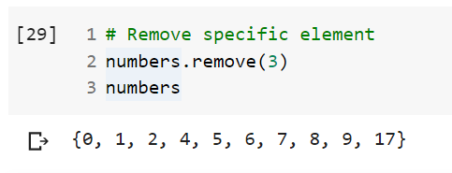
Set methods (contd.)

Slide 17
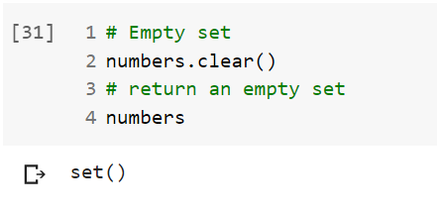
Set methods (contd.)

Slide 18
Set indexing
Set indexing isn’t valid
TypeError !
In [1] : colors = {'red', 'orange', 'yellow', 'green', 'red' ,'blue'}
In [2] : colors[0]
Out[2] : Traceback (most recent call last):
File "<stdin>", line 1, in <module>
TypeError: 'set' object is not subscriptable
error

Slide 19
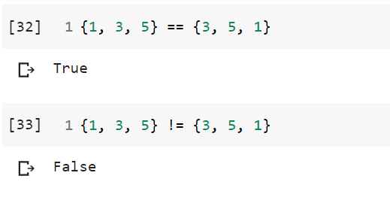
Set operations

Slide 20
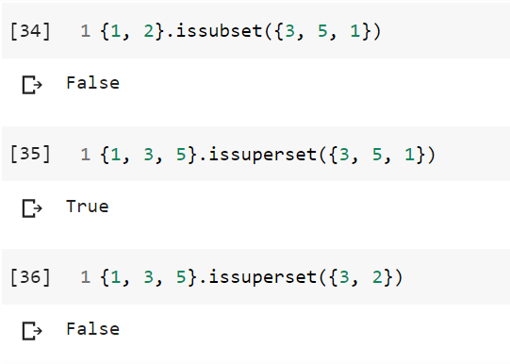
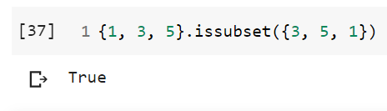
Set operations

Slide 21
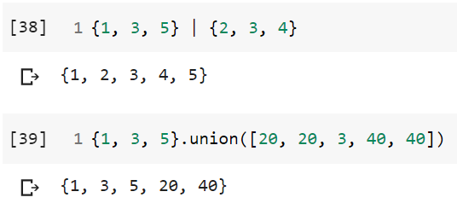
Mathematical operations
Mathematical union operations
| or union used for that

Slide 22
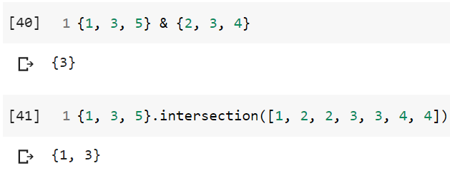
Mathematical operations
Mathematical intersection operations
& or intersection used for that

Slide 23
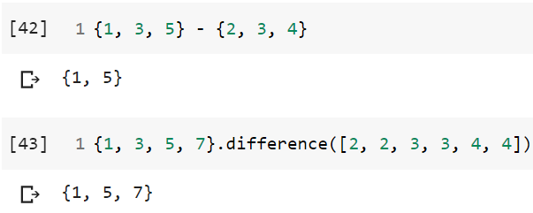
Mathematical operations
Mathematical difference operations
- or difference used for that

Slide 24
Thank you all !

